Slide 1
Recreating Images From Inside The Human Brain using AI
Nipun Bhushan

Slide 2
What’s it all about?
A team of researchers from Kyoto University in Japan used machine-learning to recreate images from pictures people were looking at or to the things they remember seeing.
Using functional magnetic resonance imaging (fMRI), the team was able to reconstruct images seen by our brains.
A number of images were presented, that were recreated by the artificial intelligence, known as a deep neural network (DNN). Each image was recreated pixel by pixel by the DNN, generating images that resembled the initial image.

Slide 3
What’s been used here
Functional magnetic resonance imaging or fMRI measures brain activity by detecting changes associated with blood flow. This technique relies on the fact that cerebral blood flow and neuronal activation are coupled. When an area of the brain is in use, blood flow to that region also increases.
Artificial neural network or Deep Neural network (DNN) is a computational model that consists of several processing elements that receive inputs and deliver outputs based on their predefined activation functions.
A generative adversarial network or Deep Generative Networks (DGN) is a machine learning model in which two neural networks compete with each other to become more accurate in their predictions. GANs typically run unsupervised and use a cooperative zero-sum game framework to learn.

Slide 4
But it’s been done earlier, what was different there?
Sophisticated decoding and encoding models have been developed earlier to render human brain activity into images or movies, the methods were essentially limited to the image reconstruction with low-level image bases.
Therefore, it failed to combine visual features of multiple hierarchical levels. Furthermore, while several recent attempts introduced deep neural networks (DNNs) into visual image reconstructions, they also did not fully utilize hierarchical information to reconstruct visual images.

Slide 5
Ah! So, that’s the breakthrough
The research showed that visual cortical activity (visual features) can be decoded (translated) into hierarchical features of a deep neural network (DNN) for the same input image, providing a way to make use of the information from hierarchical visual features.
A novel image reconstruction method is presented, in which the pixel values of an image are optimized to make its DNN features similar to those decoded from human brain activity at multiple layers.

Slide 6
The Flow~~
Firstly, the DNN features are decoded from fMRI signals as an input.
Now, the reconstruction algorithm starts from a random image and iteratively optimize the pixel values so that the DNN features of the input image become similar to those decoded from brain activity across multiple DNN layers. The resulting optimized image is assumed as the reconstruction from the brain activity.
The deep generator network (DGN) is also used as a prior to constrain reconstructed images to be similar to natural images.

Slide 7
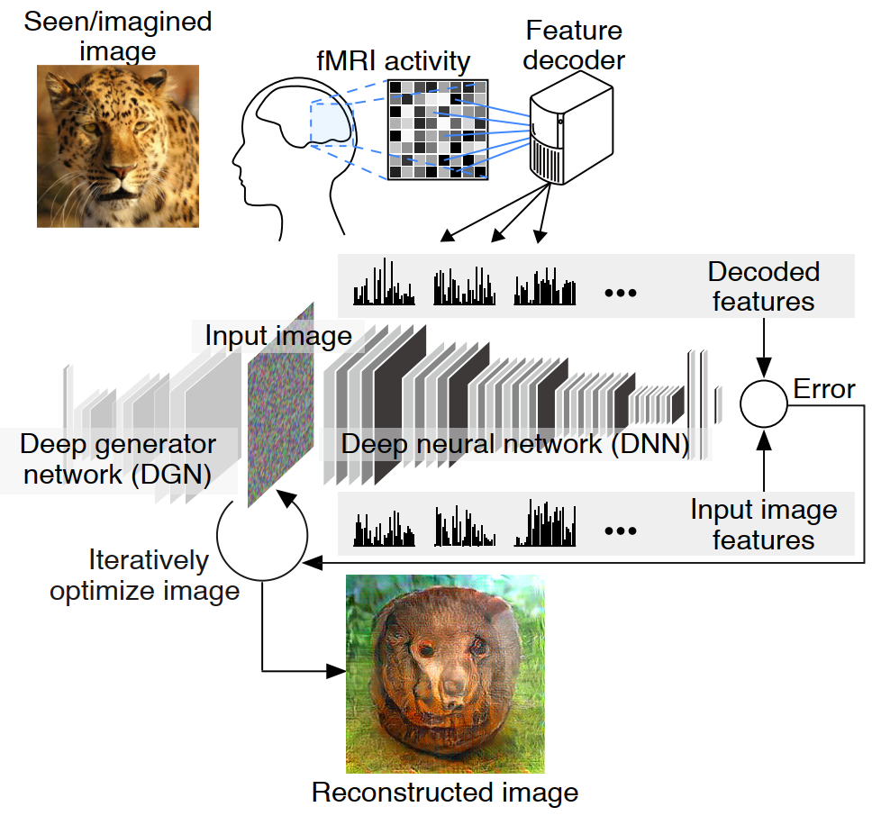
Drill down!

Slide 8
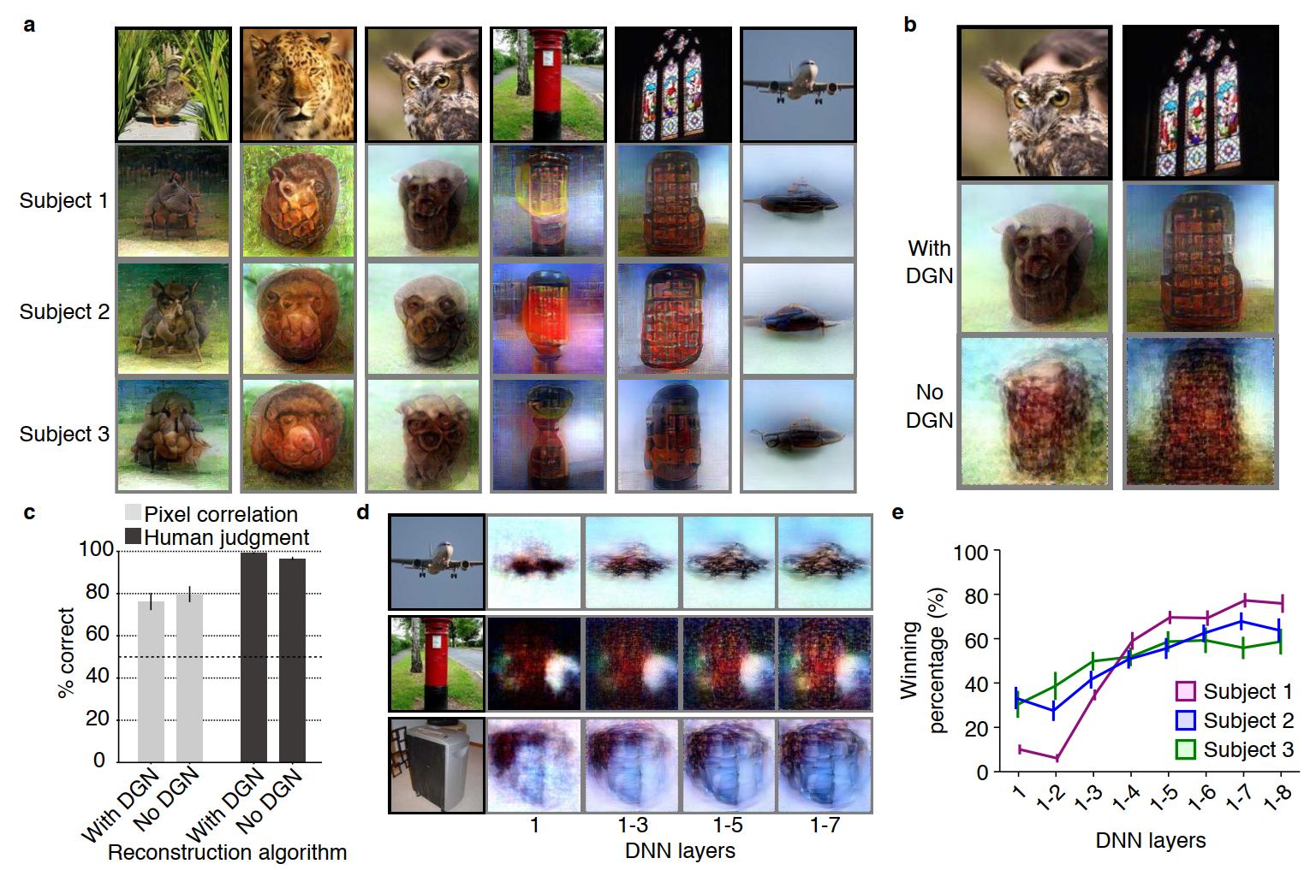
Drill down!

Slide 9
Thank you

